Slide 1

Building Up End-to-End Deep Learning Environment from Open Source Frameworks
One Click Deep Learning
Presenter: Boqian Wang
Concordia University
Gina Cody School of Engineering and Computer Science
Copyright © 2019. Concordia University All rights reserved.
10/18/2019

Slide 2



What are containers ?
Ref:https://aws.amazon.com/containers/
Standardized packaging for software and dependencies
Share an operating system on the server
Run as resource-isolated processes
Work with all major Linux and Windows Server
1979
2000
2004
2008
2013
2013
2016
Unix V7 chroot
Solaris Containers
Google Container Stack
Docker for Windows
FreeBSD Jails
LinuX Containers
Docker Containers
Get a modern PowerPoint Presentation that is beautifully designed

Slide 3
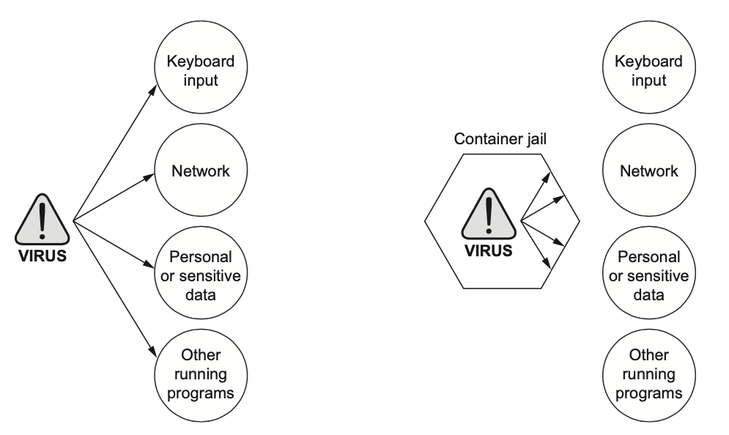
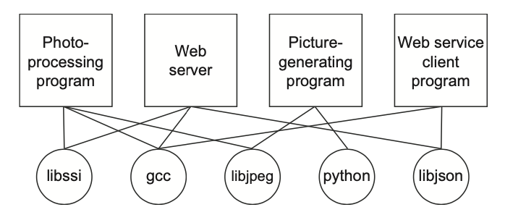
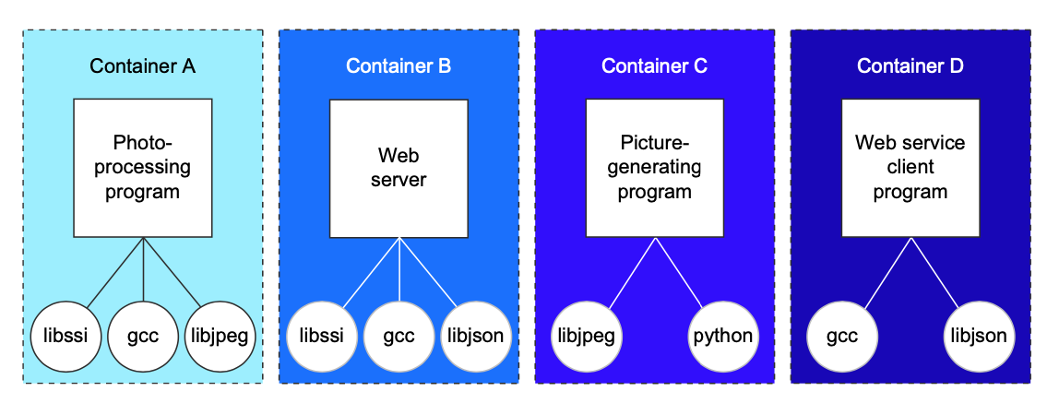
Why containers?
Improving portability
Protecting your computer
Getting organized
Ref:Docker In Action by Jeff Nickoloff

Slide 4
Kubernetes
A container orchestration engine for automating deployment, scaling, and management of containerized applications
Simplifying application deployment
Achieving better utilization of hardware
Health checking and self-healing
Automatic scaling
Integrating third party services
Outstanding community and industry support
Ref:https://www.aquasec.com/wiki/display/containers/Kubernetes+Architecture+101

Slide 5
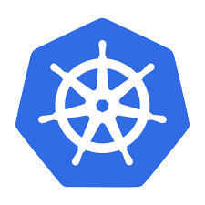
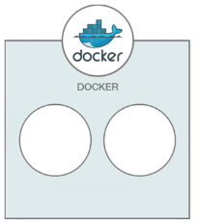




Docker and K8s in OCDL
Running Python and Jupyter notebook server in a container
Hybrid CPU/GPU clusters for high performance computing
Deploying, managing and scaling clusters with Kubernetes
Data virtualization using HDFS
Accessing data at memory speed with Alluxio
CPU Cluster
GPU Cluster

Slide 6



Cross cloud platform resources integration
3.87.64.X
3.89.28.X
10.8.0.1
10.8.0.2
AWS instance
Azure instance
AWS instance
Azure instance
$$✘$$
✓
$$✘$$
$$✘$$
✓
✓
✔︎
Local machine
Local machine
Local machine
Local machine
✓
✓
192.168.0.2
192.168.0.3
10.8.0.4
10.8.0.8

Slide 7
Kubernetes installation
Installing Kubernetes from binaries
Preparing your cluster
Setting up master
Setting up cluster network
Configure network.
Turn down firewall, SELinex and swap.
Sync server time with NTP.
Install kube-apiserver, kube-controller manager and kube-scheduler.
Install CNI plugin.
Options are Calico, Flannel, Canal, etc.
Setting up etcd cluster
Setting up node
Setting up DNS service
Etcd cluster will select a leader.
The other nodes will be followers.
Make sure the number of nodes in your etcd cluster is odd.
Install docker, kubelet and kube-proxy.
Kube-dns
CoreDNS
Additional Configuration Options

Slide 8
Kubernetes installation
Installing Kubernetes with Minikube
01 - Install VirtualBox
02 - Install Kubectl
03 - Install Minikube
01 - Install components
02 - Initiate Master node
03 - Install pod network add-on
04 - Working node join cluster
Installing Kubernetes with Kubeadm

Slide 9
Which one to choose?
Binaries
Minikube
Kubeadm
Very complicated to set up a production-ready Kubernetes cluster
Have to be very good at Linux and network management
A perfect way to learn
Kubernetes
Runs a single-node Kubernetes cluster inside a Virtual Machine (VM)
Very easy to set up a single-node k8s cluster
For testing and deployment only
Should not be used on production
Easy to set up a production-ready Kubernetes cluster
Provides a foundational implementation for k8s cluster setup and administration
Flexible enough to support a wide variety of deployment options

Slide 10
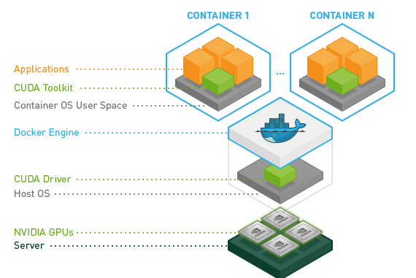
Docker image for deep learning
01
Build image from scratch
Install python, libraries, jupyter notebook, etc. by yourself. Can be complicated for GPU since you have to worry about CUDA toolkit.
02
Get base image or dockerfile from docker hub
To get or build your base images just using one command and modify it for your use.
You have to find those repositories.
e.g. Nvidia/cuda and tensorflow/tensorflow
Ref:https://github.com/NVIDIA/nvidia-docker

Slide 11
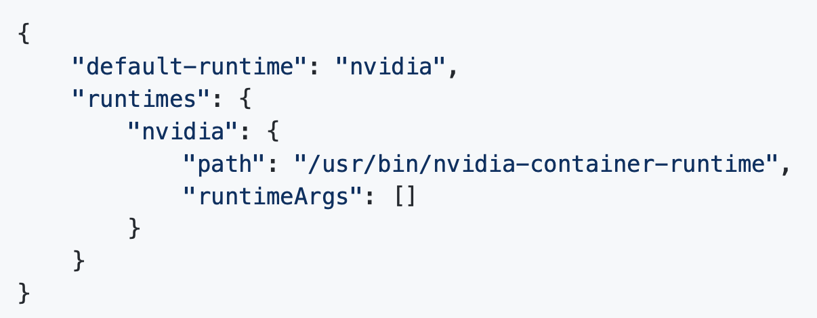
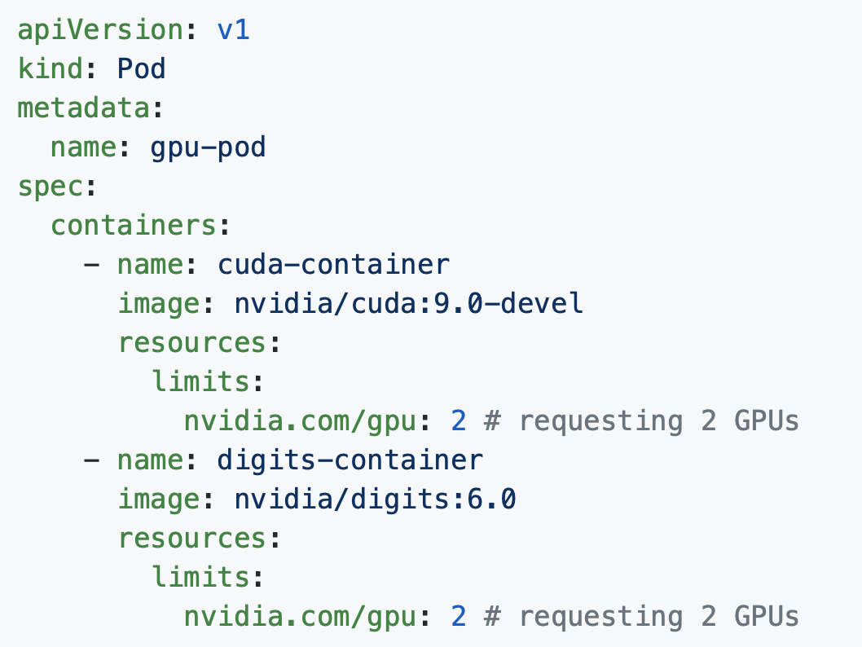
GPUs scheduling in K8s
From 1.8 onwards, the recommended way to consume GPUs is to use device plugins
1. Preparing GPU nodes
3. Running GPU jobs
NVIDIA device plugin
2. Enabling GPU support
in Kubnernetes
Prerequisites:
NVIDIA drivers ~= 361.93
Nvidia-docker version > 2.0
Nvidia as the default runtime
Kubernetes version >= 1.10
kubectl create -f https://raw.githubusercontent.com/NVIDIA/k8s-device-plugin/1.0.0-beta/nvidia-device-plugin.yml

